Slide 1
EURONEURO

Slide 2
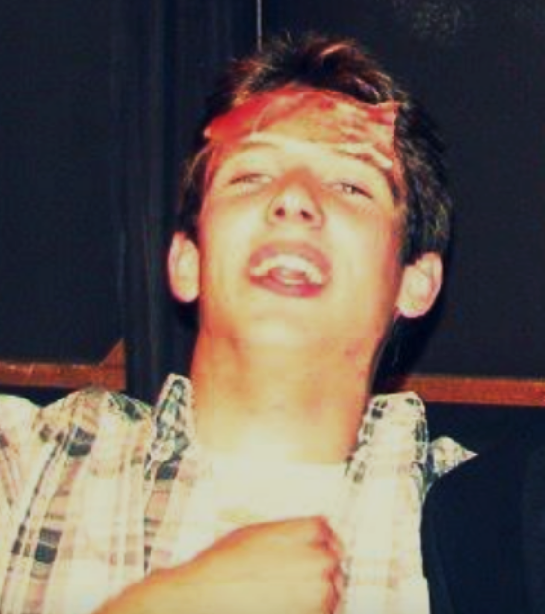
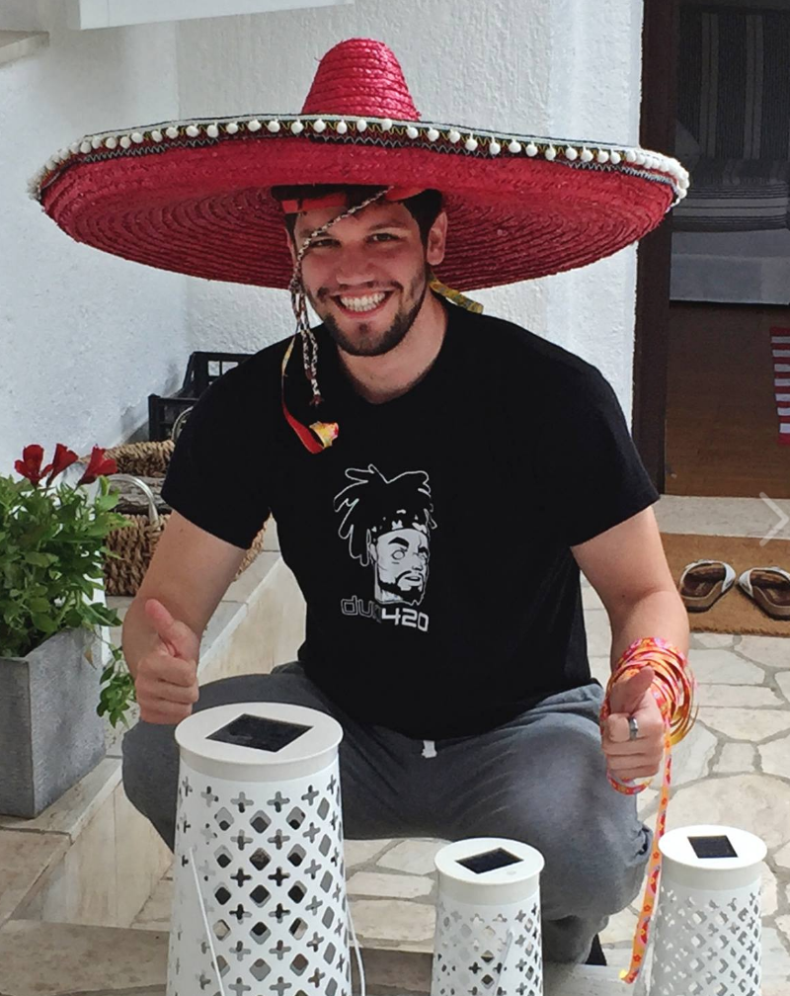
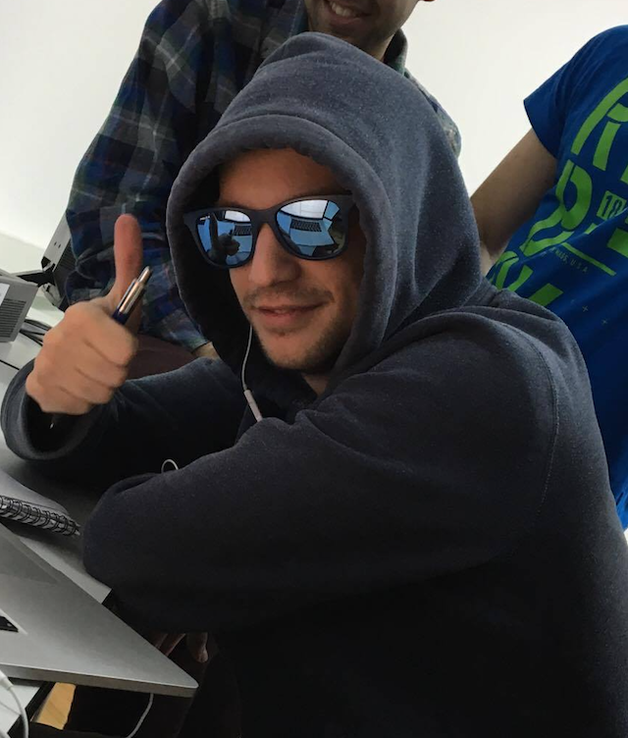
The Team
Filip
Bartol
Damir

Slide 3

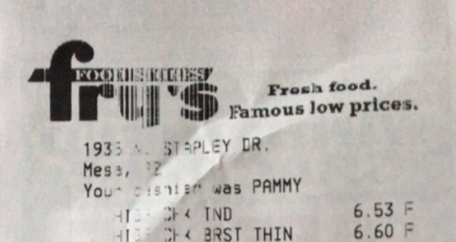
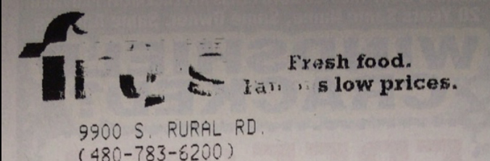
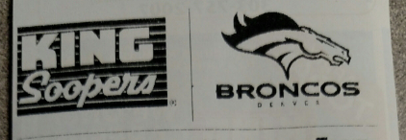
Hard examples
Notes:
Isti logo
Logo se mijenja izgled
Osteceni logo

Slide 4
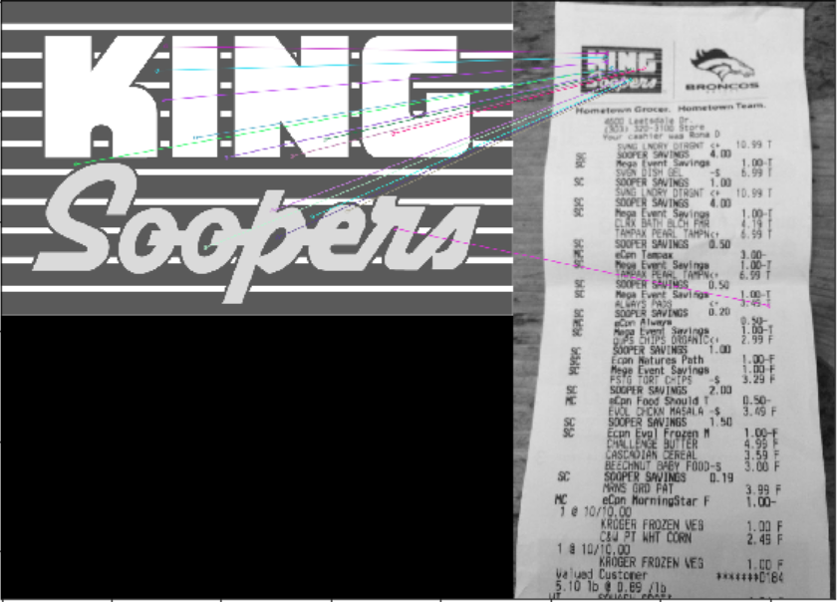
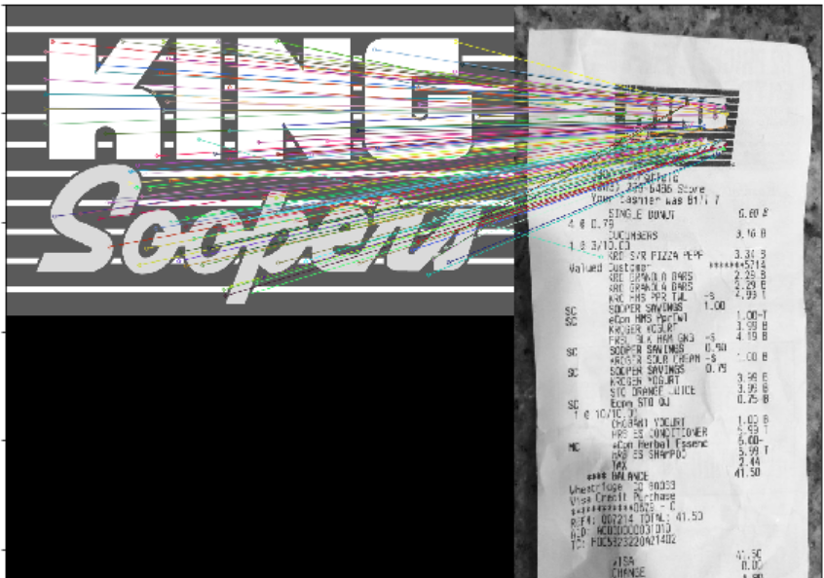
SIFT – slow but it’s working!
Notes:
Prva ideja SIFT
Radi OK ali jako sporo

Slide 5
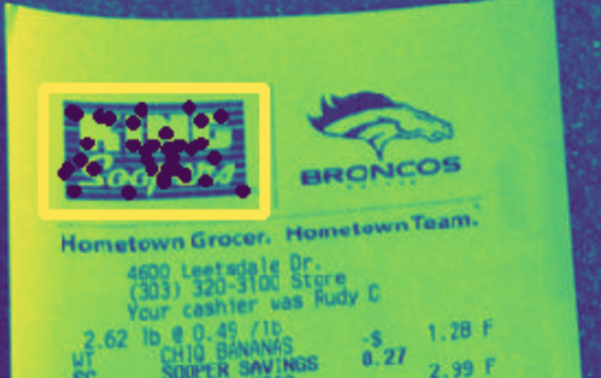
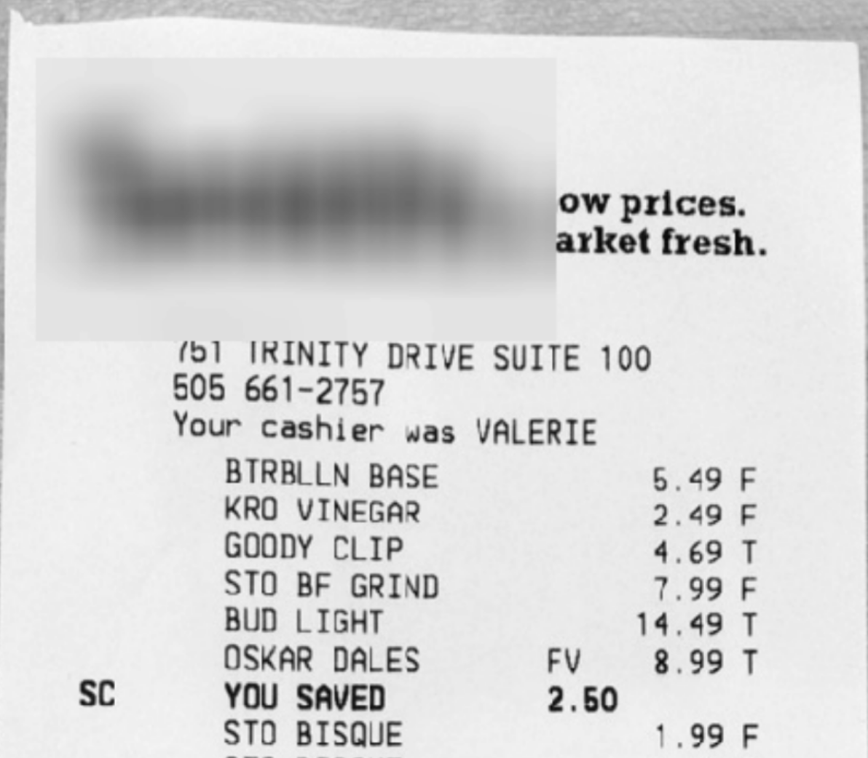
SIFT as an object detection?
Notes:
Sift u druge svrhe
Koristili ga kako bi pronašli logo
Augumentacija dataseta
Pokušaj da se algoritam fokusira na logo

Slide 6
What we tried
Resolutions
Augmentations
20+
Datasets
different
approaches
Architectures
Losses
Heuristics
Notes:
Sa otherom ili bez / Random images
Xception / Squeeze / Kaskade
Focal / Center

Slide 7
Additional datasets
Old logos
10k
40k
New retailers
new receipts
non receipts
Random images

Slide 8
Augmentations
Zoom in / out
Random erase
Rotation
Brightness / Contrast
Upper crop
Notes:
Zoom in / out
rotation
Random erase

Slide 9
Final solution
Upper crop + Grayscale
SqueezeNet
Cross Entropy + Center Loss
Thresholding
Classification
Notes:
Zoom in / out
rotation
Random erase

Slide 10
Model analysis

Slide 11
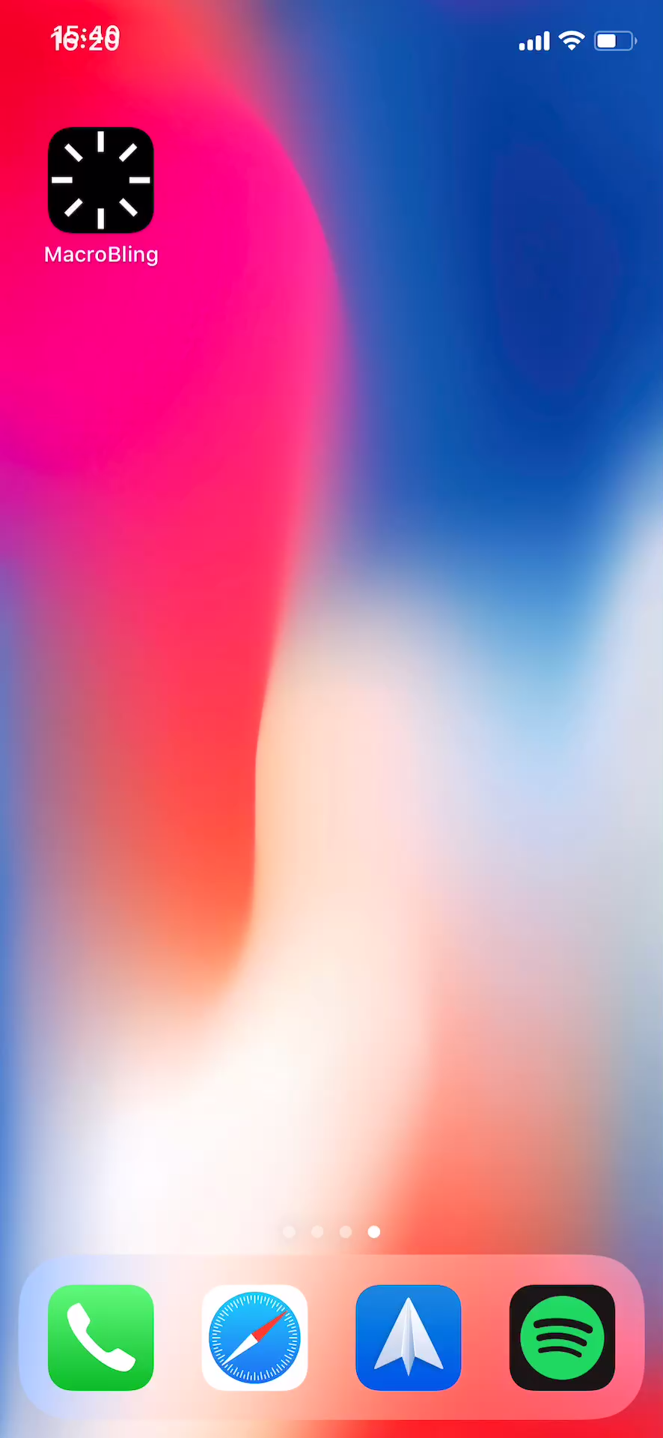
iOS
Demo

Slide 12
Q&A

Slide 13
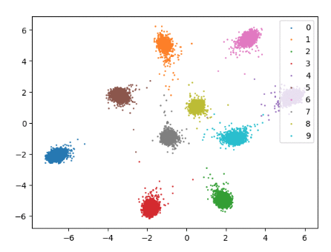
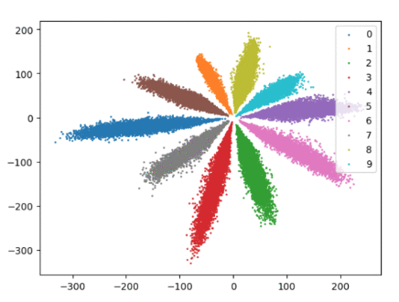
Center Loss (F1 score += 2%)

Slide 14
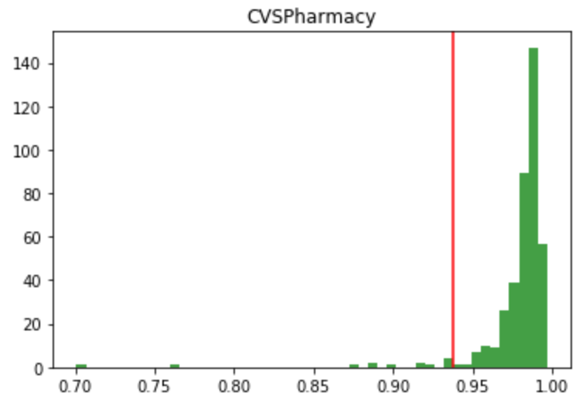
Thresholding

